Slide 1
Robotics Sensing and Navigation EECE 5554
GROUP-7

Slide 2
VISUAL SLAM
Robotics Sensing and Navigation EECE 5554
Real-Time Appearance-Based Mapping
Jose Thandapral
Siddharth Maheshwari
Smruti Suresh
Kshama Dhaduti

Slide 3
SCOPE OF THE PROJECT
Robotics Sensing and Navigation EECE 5554
Implementing RTAB Mapping using ZED Mini camera.
Implementing April Tag detection.
Data collection.
Qualitative Analysis
RTAB Mapping using iPhone application.

Slide 4
VISUAL SLAM
Robotics Sensing and Navigation EECE 5554
Visual SLAM (Simultaneous Localization And Mapping) is a process of calculating the position and orientation of the camera with respect to its surrounding while simultaneously mapping the environment .
It uses images from camera to map and localize, here we are using a stereo camera-ZED Mini.
Visual SLAM tracks the points through each successive camera frame and triangulates to form 2D/3D map.
Sufficient point detection assist with rapid environment mapping and better orientation of the sensor.
All visual SLAM systems are constantly working to minimize reprojection error, or the difference between the projected and actual points, usually through an algorithmic solution called bundle adjustment.
Visual SLAM systems need to operate in real-time, so often location data and mapping data undergo bundle adjustment separately, but simultaneously, to facilitate faster processing speeds before they’re ultimately merged.

Slide 5
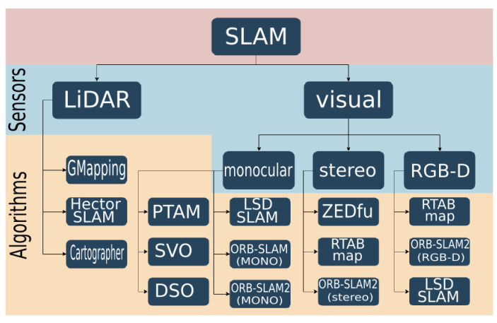
Robotics Sensing and Navigation EECE 5554

Slide 6
RTAB MAPPING
Robotics Sensing and Navigation EECE 5554
RTAB-Map (Real-Time Appearance-Based Mapping) is a RGB-D, Stereo and Lidar Graph-Based SLAM approach based on an incremental appearance-based loop closure detector.
The loop closure detector uses a bag-of-words approach to determinate how likely a new image comes from a previous location or a new location.
When a loop closure hypothesis is accepted, a new constraint is added to the map’s graph, then a graph optimizer minimizes the errors in the map.
There are two types of loop closure detections: local and global.

Slide 7
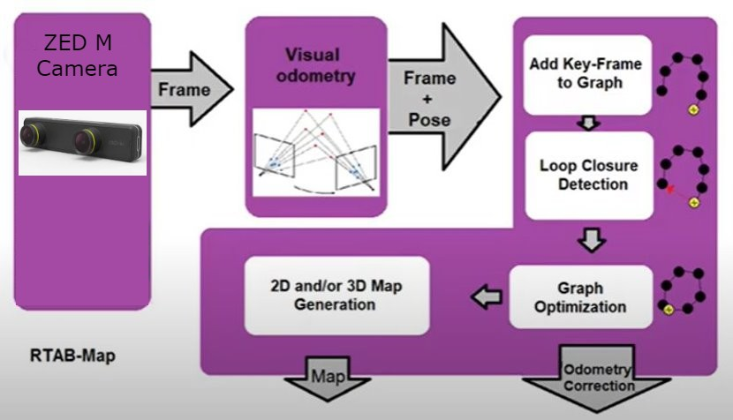
System Architecture
Robotics Sensing and Navigation EECE 5554

Slide 8
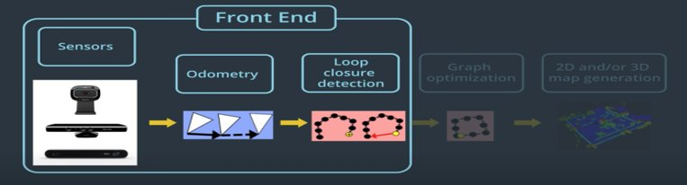
Robotics Sensing and Navigation EECE 5554
Focuses on the sensor data used to determine the constraints used in feature optimization methods.
Odometry constraints and loop closure constraints are considered.
For metric GraphSLAM, RTAB-Map requires an RGB-D camera or a stereo camera to compute the geometric constraint between the images of loop closure.
The front end also involves graph management, which includes node creation and loop closure detection using bag-of-words

Slide 9
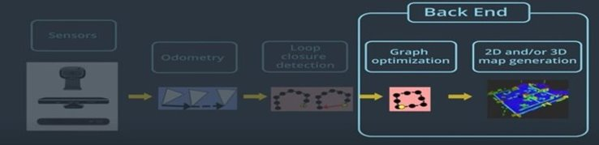
Robotics Sensing and Navigation EECE 5554
Includes the graph optimization and an assembly of an occupancy grid from the data of the graph.
When a loop closure hypothesis is accepted, a new constraint is added to the map’s graph, then a graph optimizer minimizes the errors in the map.
All of these optimizations use node poses and link transformations as constraints. When a loop closure is detected, errors introduced by the odometry can be propagated to all links, correcting the map.
Only odometry constraints and loop closure constraints are optimized.

Slide 10
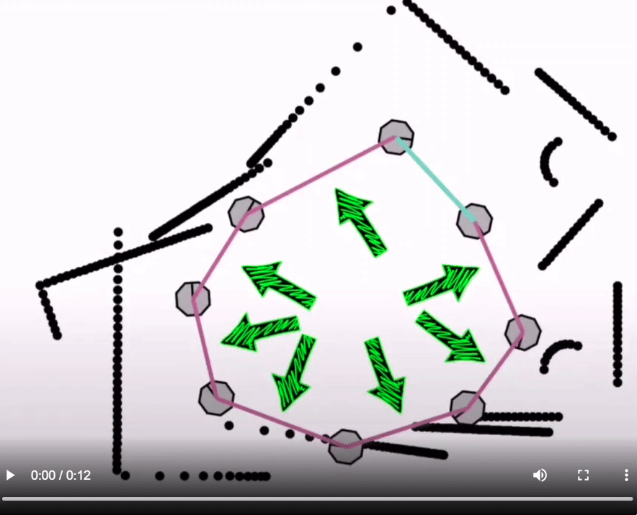
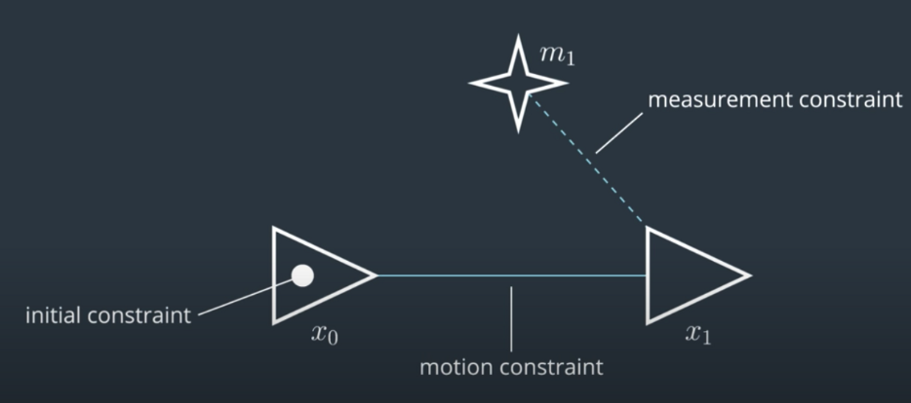
Graph SLAM
Robotics Sensing and Navigation EECE 5554
The algorithm recovers the entire path and map instead of just the recent pose and map. Creates constrains between nodes.

Slide 11
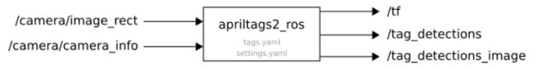
APRIL TAGS
Robotics Sensing and Navigation EECE 5554
We are implementing April tags to detect landmarks.
Detector for continuous image (i.e. video) stream.
tag_family (string, default: tag36h11)
The advantage of this method is that it does not require any complicated equipment.
All you need is:
Printed April tags and wall mounting them
Small embedded computer(Raspberry Pi or similar) with camera (Global shutter preferred)

Slide 12

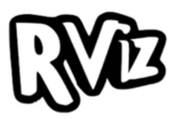

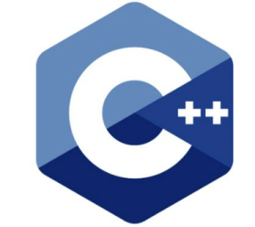


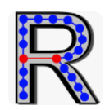


SOFTWARE TOOLS
Robotics Sensing and Navigation EECE 5554
ROS noetic
PYTHON3
RVIZ
RTAB Map
C++
OpenCV
apriltag_ros wrapper
rtabmap_ros
zed_ros_wrapper

Slide 13
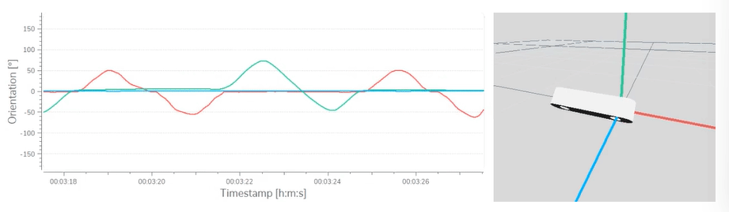
HARDWARE
Robotics Sensing and Navigation EECE 5554
ZED-Mini camera
The ZED family of depth cameras is a multi-sensor platform. The cameras have built-in sensors to add position and motion-assisted capabilities to your app, like accelerometer and gyroscope sensors.
The sensors can be used to detect camera movements, compute the camera orientation according to the north magnetic pole, detect relative altitude variations, and much more.

Slide 14
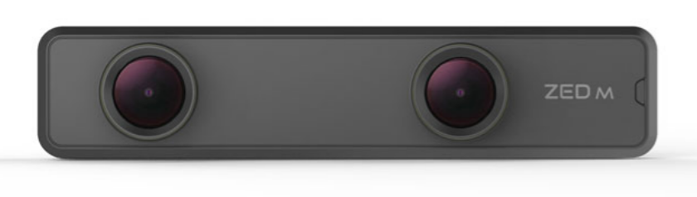
ZED MINI SPECS
Robotics Sensing and Navigation EECE 5554
In-built IMU (Accelerometer, Gyroscope)
Depth range - 0.1 - 15 m (0.32 to 50 ft)
Image sensor - Dual 4M pixels sensors with large 2-micron pixels
Connectivity - USB 3.0 Type-C port
Power - Power via USB 5V / 380mA
Compatible OS - Windows, Ubuntu, Debian, Jetson
Third-party Integrations – ROS, Python, C++, C#,MATLAB, OpenCV, pcl , Unity, TensorFlow
SDK System Requirements - Dual-core 2.3GHz or faster processor|4 GB RAM or more| Nvidia GPU with compute capability > 3.0

Slide 15
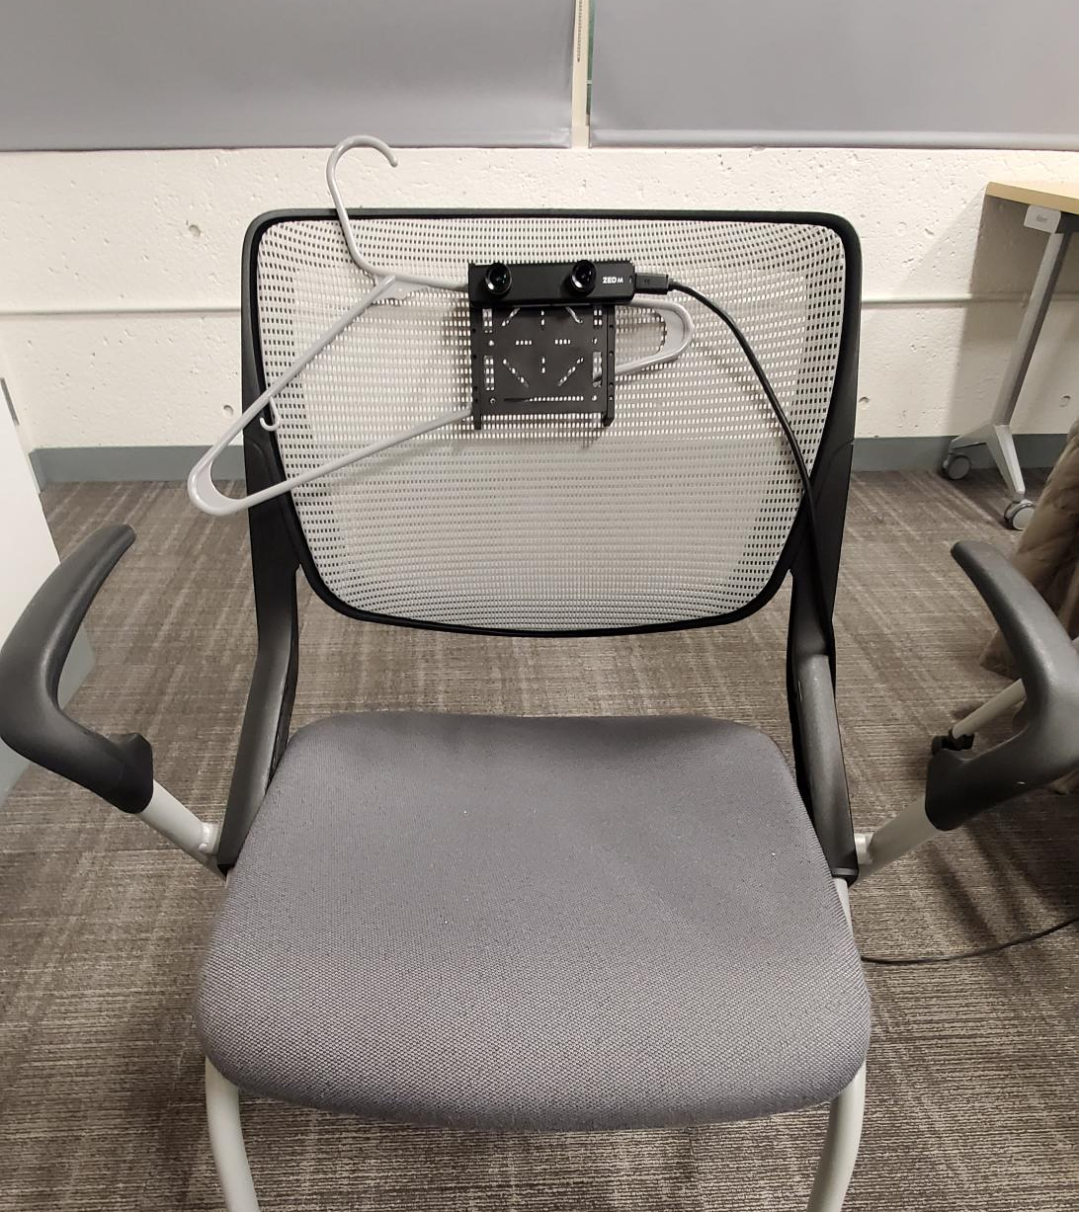
SET UP
Robotics Sensing and Navigation EECE 5554
Camera fixed to a chair for steady Z axis stability.
Ensured ease of movement.
Observed better localization and loop closures when fixed to a chair.

Slide 16
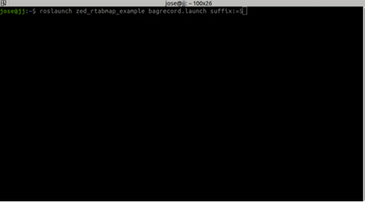
IMPLEMENTATION
Robotics Sensing and Navigation EECE 5554
Launch file for rtabmap (zed-ros-examples).
Launch file for recording rosbag.
Launch file for April tag detection.
SLAM mode
Switch to localization

Slide 17
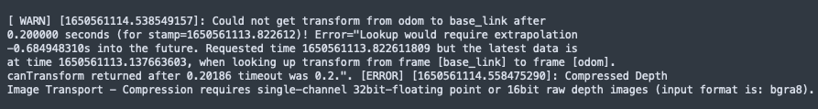
ISSUES FACED IN IMPLEMENTATION
Robotics Sensing and Navigation EECE 5554
Time sync error
Transformation error (from base link to odom-frame )
Compressed image transport error
cv::bridge error
Observations:
Insufficient features in the environments ( for example, white walls).
Dedicated depth sensors (in RGB-D) or depth from LiDAR scans give better results for 3D reconstruction than the depth obtained from stereo depth sensing.

Slide 18
PARAMETER TUNING
Robotics Sensing and Navigation EECE 5554
RTAB-Map's performance can be improved by tuning various parameters.
Variety of strategies can be used for Odometry, Optimizer, Feature Detection, Feature registration.
Odometry Strategy: Frame to Frame
Feature Detection Strategy: GFTT/ORB
Optimizer: GTSAM

Slide 19
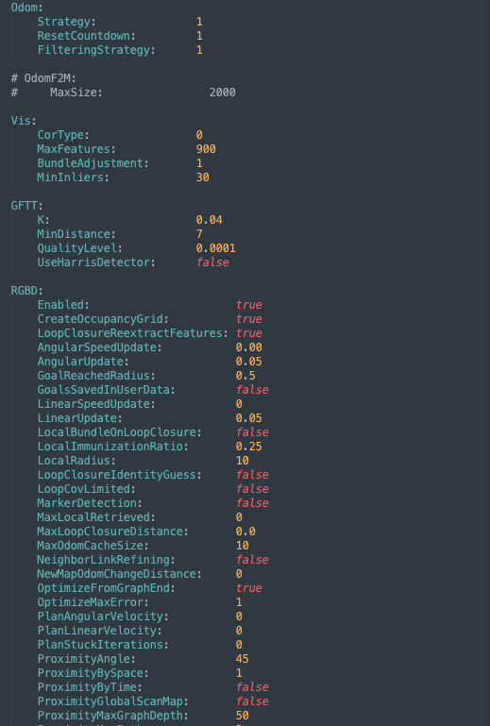
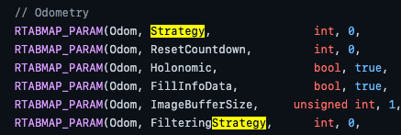
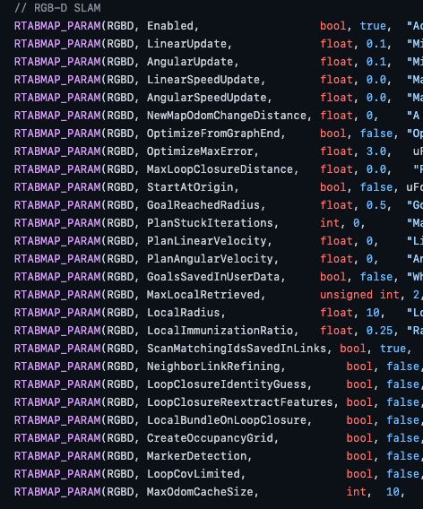
PARAMETER TUNING: COMPARISON
Robotics Sensing and Navigation EECE 5554

Slide 20
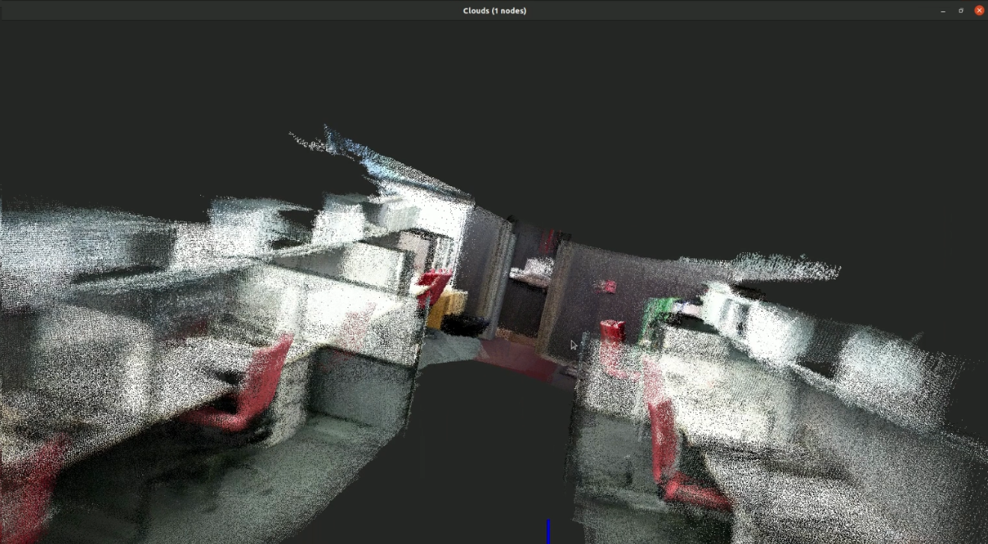
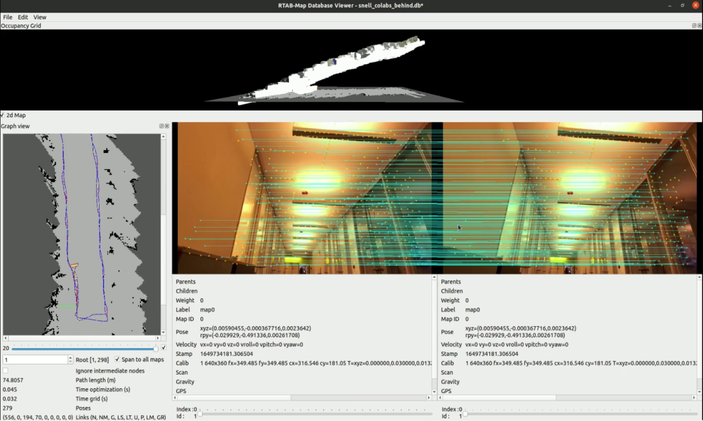
QUALITATIVE ANALYSIS OF RESULTS
Robotics Sensing and Navigation EECE 5554
2loops_workspace_3IT.db Hardware: Xtion Pro Live Camera with dedicated depth sensing
Major z-drift in initial collected databases -But obtained loop closure after a few loops (refer graph view in rsn_vid1 video)

Slide 21
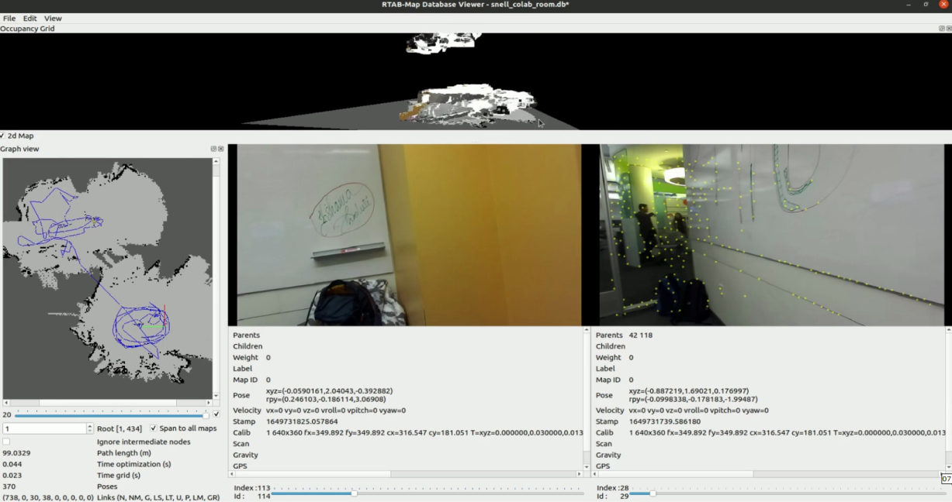
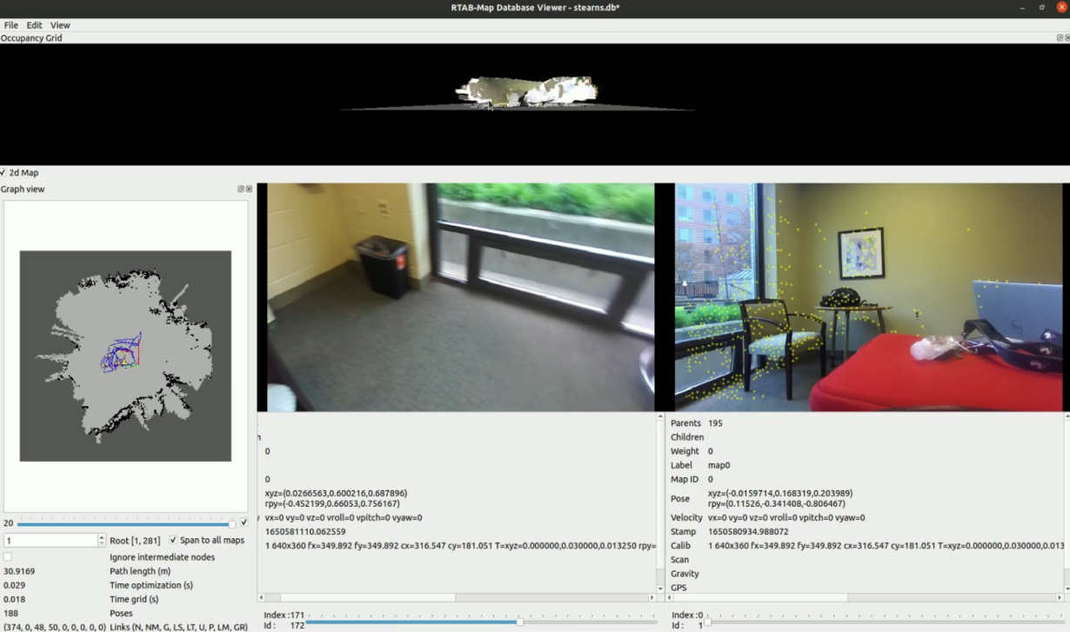
QUALITATIVE ANALYSIS OF RESULTS
Robotics Sensing and Navigation EECE 5554
Transparent surface during mapping
-Produces “pseudo” features
-resulting in new map(refer graph view)
Fixed z-drift
-setting Odom:FilteringStrategy parameter to 1(Kalman Filter)

Slide 22
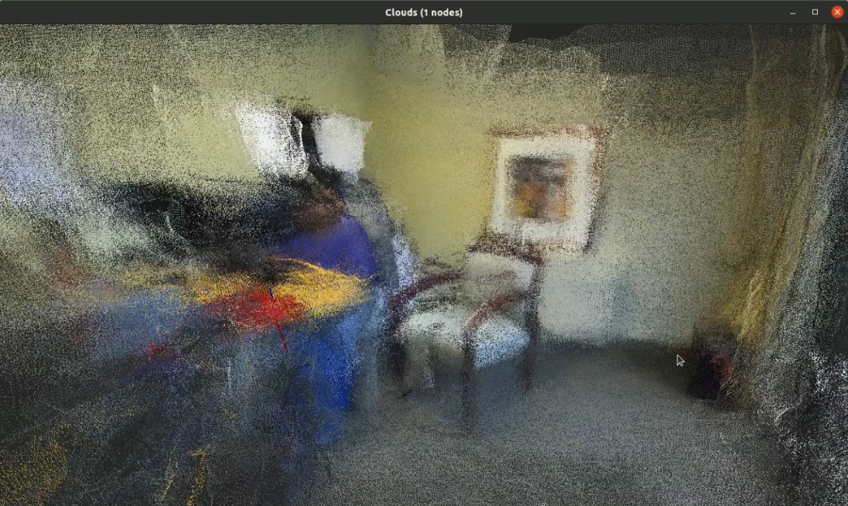
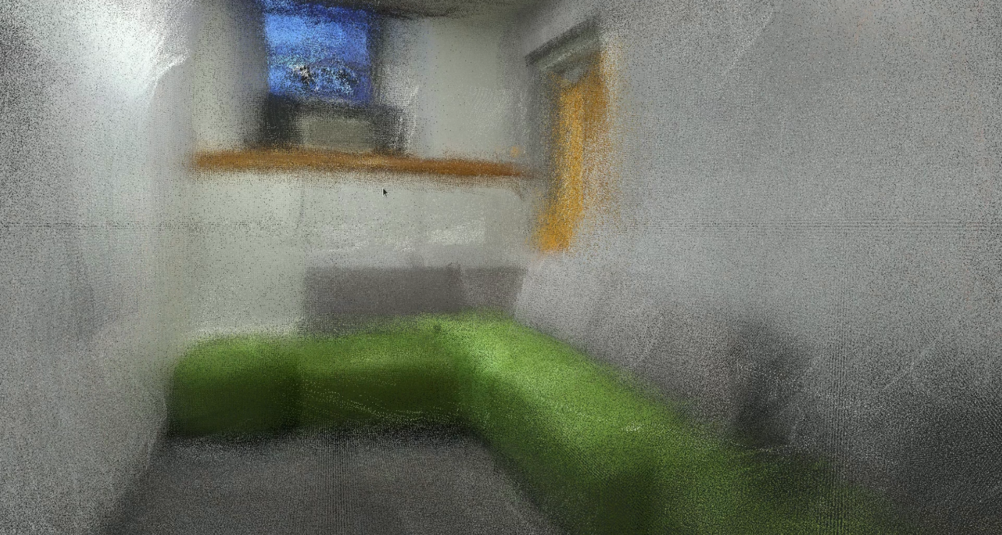
QUALITATIVE ANALYSIS OF RESULTS
Robotics Sensing and Navigation EECE 5554
Parameter tuning resulting in better localization and 3D reconstruction
-But still environment had glass surfaces(refer rsn_vid1 video )
Smaller environment with contrasting features
-results in better frame matching and 3D reconstruction

Slide 23
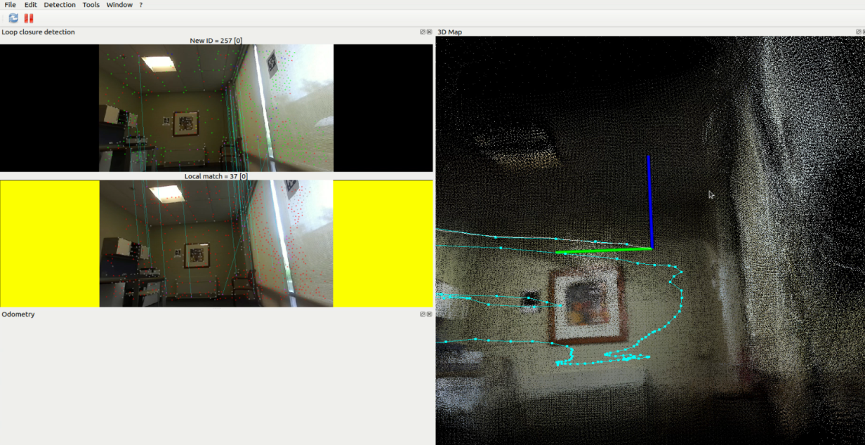
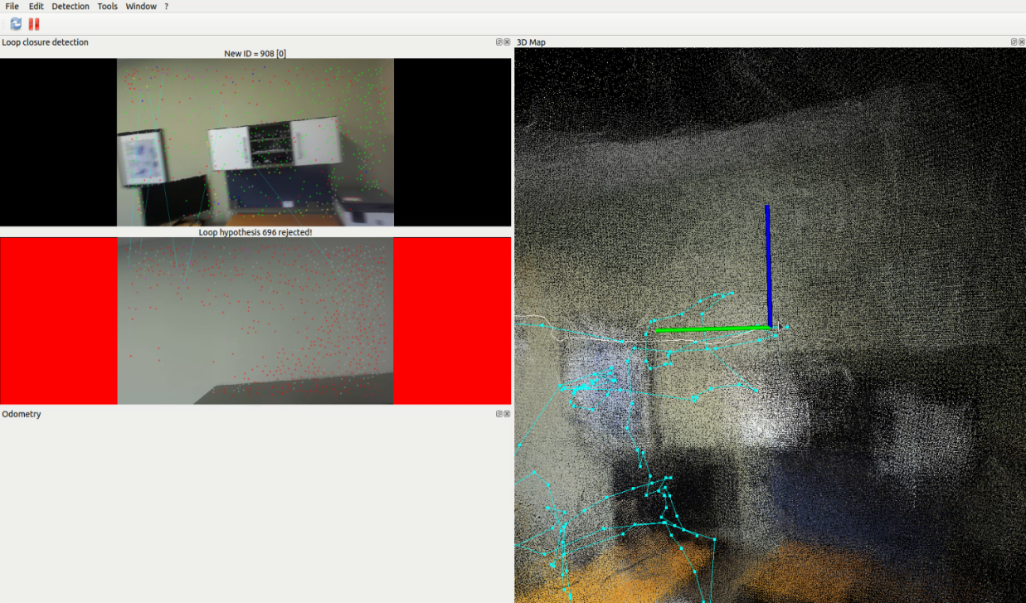
QUALITATIVE ANALYSIS OF RESULTS
Robotics Sensing and Navigation EECE 5554
Rosbag issue fixed & final mapping
-First 2 loops with chair setup for constant Z level
Handheld mapping to get different views of objects in the room

Slide 24
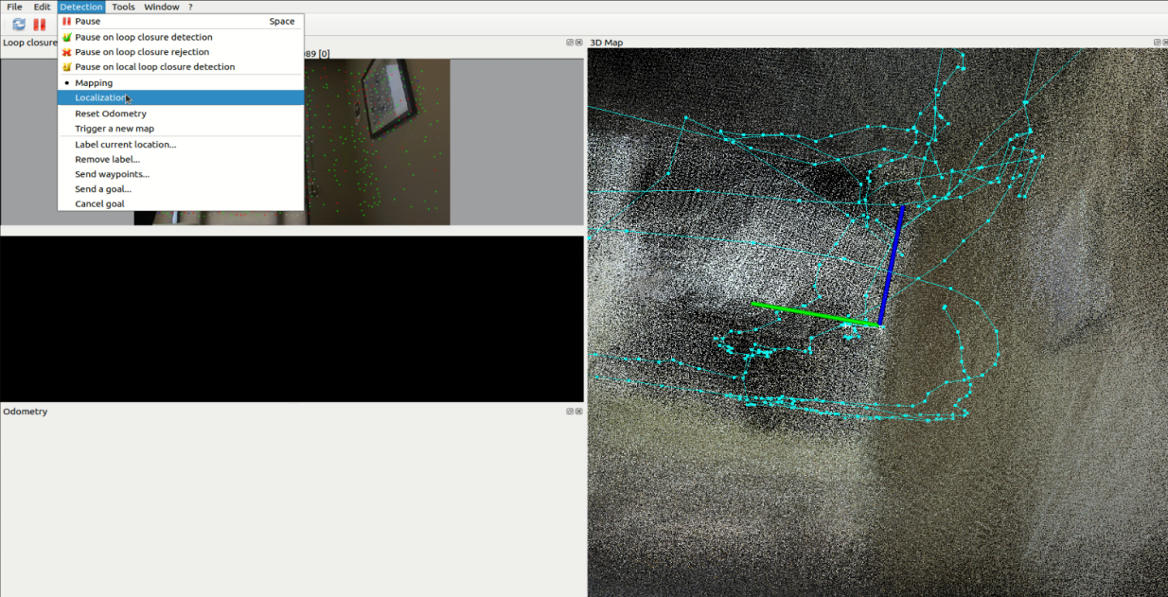
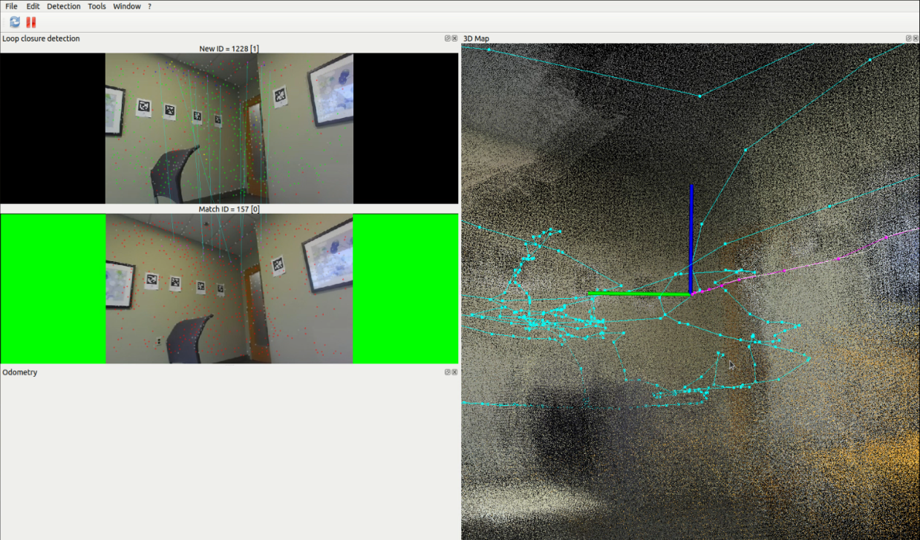
QUALITATIVE ANALYSIS OF RESULTS
Robotics Sensing and Navigation EECE 5554
Switching to pure localization
Pink trajectory shows the localization after the environment is sufficiently mapped

Slide 25
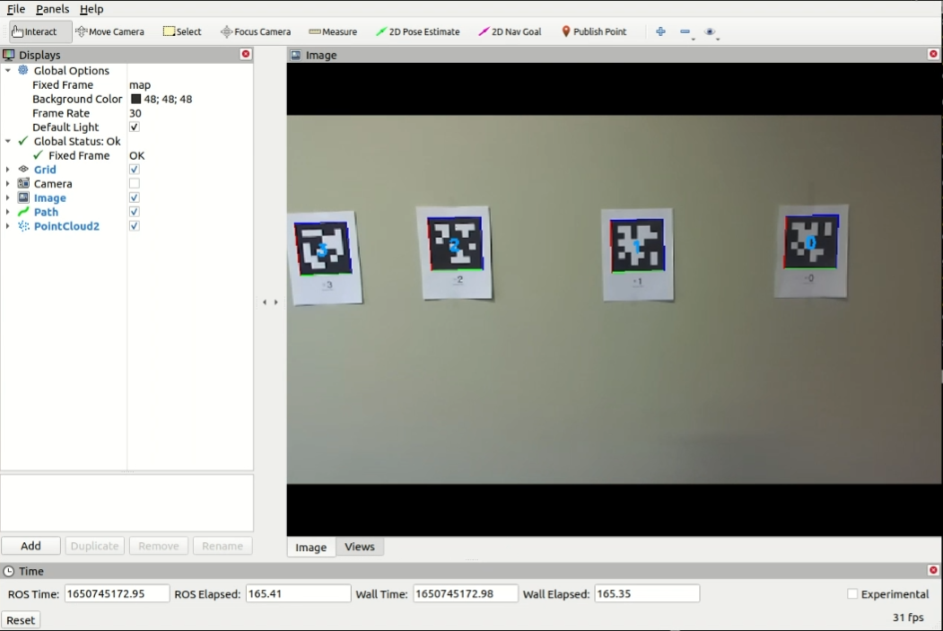
QUALITATIVE ANALYSIS OF RESULTS
Robotics Sensing and Navigation EECE 5554
April tags detected with bounding boxes and central TagID# display

Slide 26
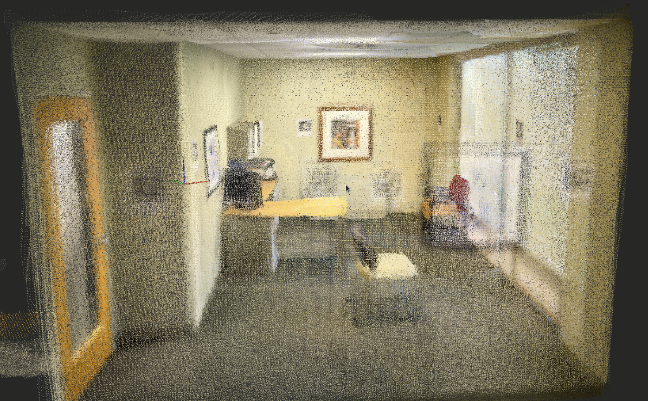
iPhone RTAB MAP
Robotics Sensing and Navigation EECE 5554

Slide 27
CONCLUSION AND FUTURE SCOPE
Robotics Sensing and Navigation EECE 5554
RTAB-Map was successfully implemented for performing SLAM followed by standalone localization within a prebuilt map.
Loop closures were frequently observed which is a qualitative indicator of SLAM performance.
Glass windows and door were a problem we came across, RTAB couldn’t do 3D reconstruction perfectly since the features on the other side of the glass were also detected and registered.
Illumination effects affected the performance of RTAB-Map. Excessive and insufficient illumination contributed to poor 3D reconstruction.
Future scope: Combine RTAB-SLAM with April tag detection and implement path planning on autonomous platforms.

Slide 28
REFERENCES
Robotics Sensing and Navigation EECE 5554
https://www.automate.org/blogs/what-is-visual-slam-technology-and-what-is-it-used-for#:~:text=How%20Does%20Visual%20SLAM%20Technology,information%20to%20approximate%20camera%20pose.
https://www.mathworks.com/help/vision/ug/visual-simultaneous-localization-and-mapping-slam-overview.html
http://introlab.github.io/rtabmap/#:~:text=Overview,location%20or%20a%20new%20location
https://www.researchgate.net/publication/264838423
https://www.stereolabs.com/zed-mini/
http://wiki.ros.org/apriltag_ros

Slide 29

Robotics Sensing and Navigation EECE 5554
TO
Sushant Govindraj Xavier Hubbard

